Slide 1

June 2023
Education System with Face Recognition and Detection Attendance
Streamlining Attendance Management with Face Recognition and Detection

Slide 2
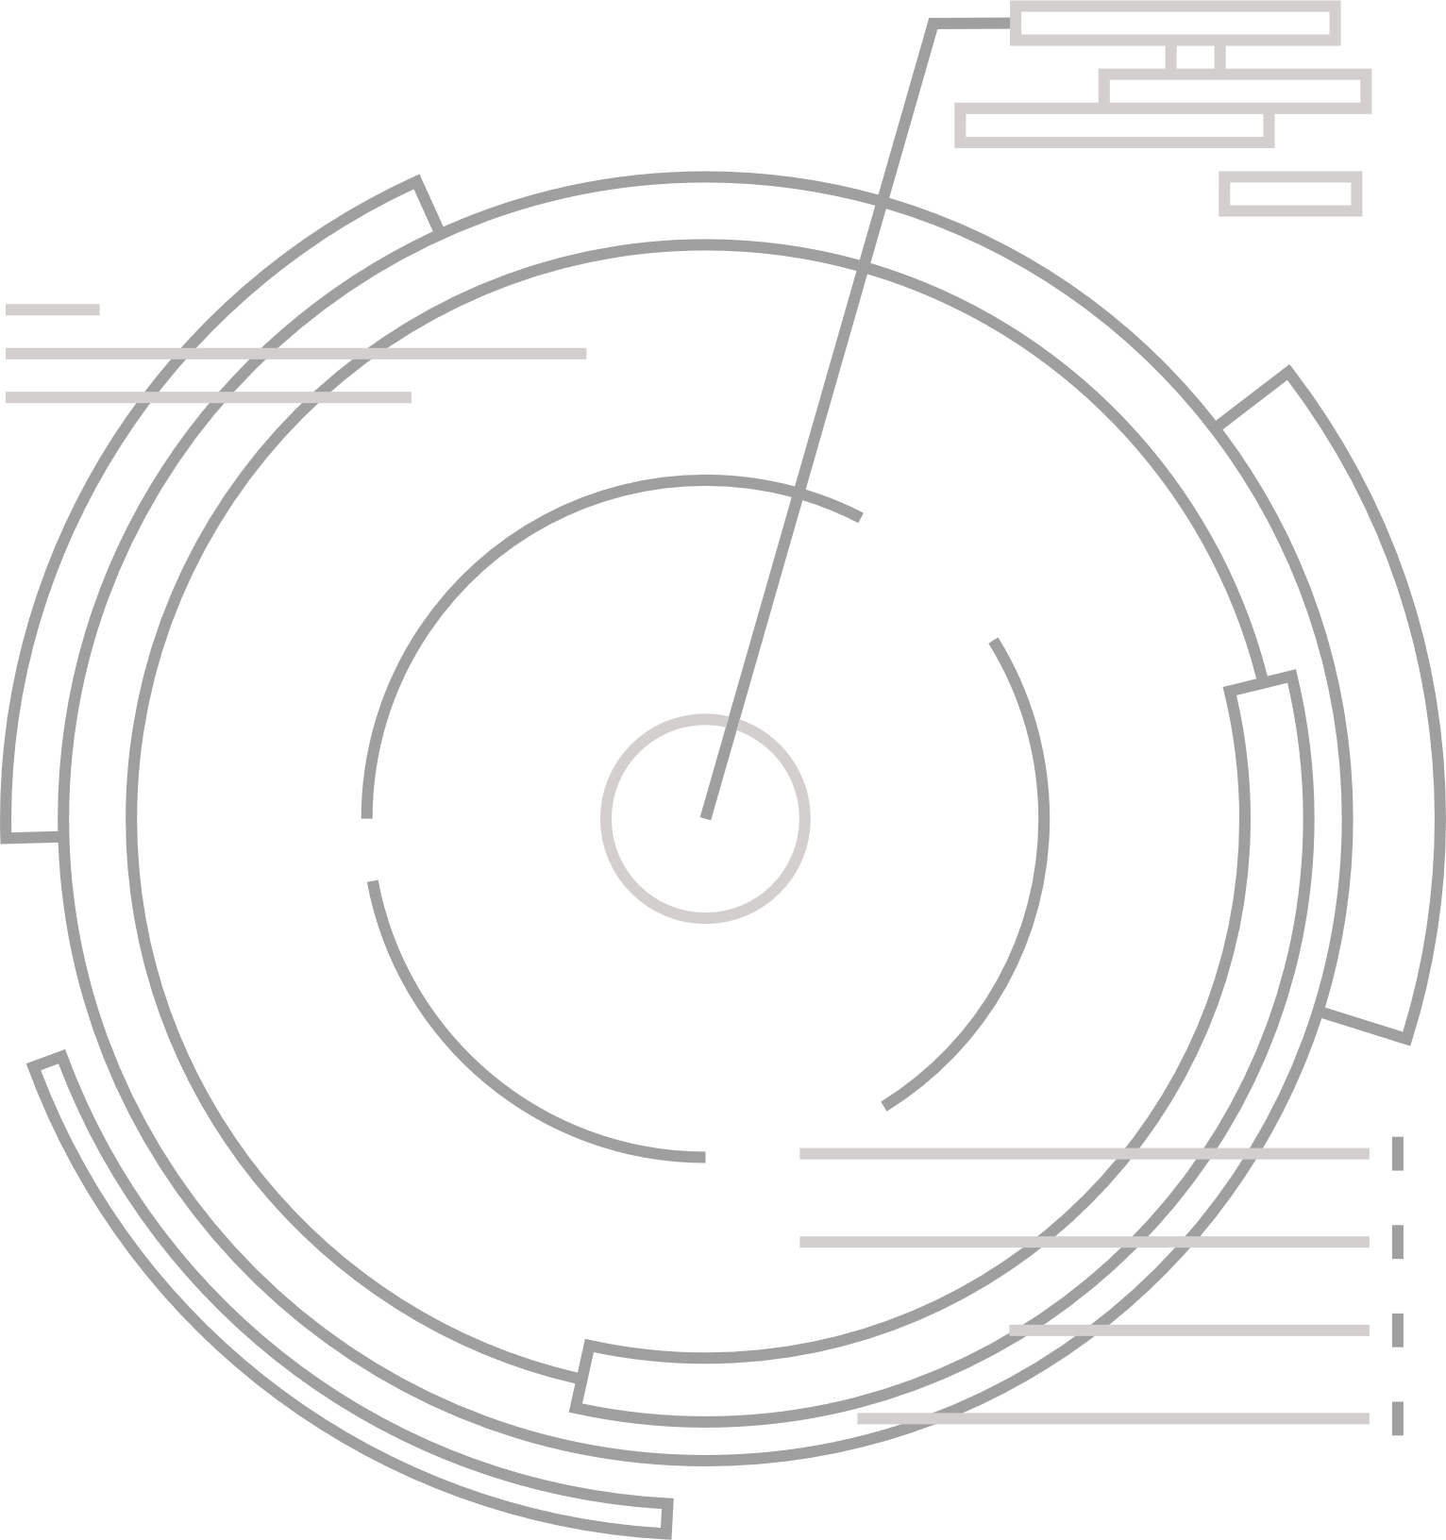

OutLine
Introduction
Problems & solutions
section : 1.0
slide : 4
section : 1.1
slide : 5
Overview
System Analysis
section : 2.0
slide : 8 & 9
section : 3.0
slide : 11
Multi-face attendance
Face detection
section : 3.1
slide : 13
section : 3.2
slide : 14
Data-set & pre-processing
Face recognation
section : 3.2
slide : 17
section : 3.3
slide : 19
System architecture
Conclusion
section : 3.4
slide : 22
section : 4.0
slide : 25

Slide 3
Introduction
Introduce the system and explain the purpose of the project

Slide 4

Attendance and education system
Attendance is a crucial aspect of education.
attendance systems have become increasingly sophisticated.
with technology enabling more accurate and efficient tracking of student attendance.
In this presentation, we will explore our attendance system and its benefits and its components

Slide 5
Problems vs Solutions
Problems
Solutions
Traditional attendance are time-consuming and error-prone.
Develop an attendance system that provide an efficient and reliable way to manage attendance.
impact on the success of an educational environment.
Technologies such as facial recognition and face detection
Instructors may have to spend valuable class time taking attendance manually.
Streamline attendance tracking and reduce errors.
Traditional methods such as roll-call or sign-in sheets can be prone to errors.
Improve attendance rates and lead to better student outcomes.

Slide 6

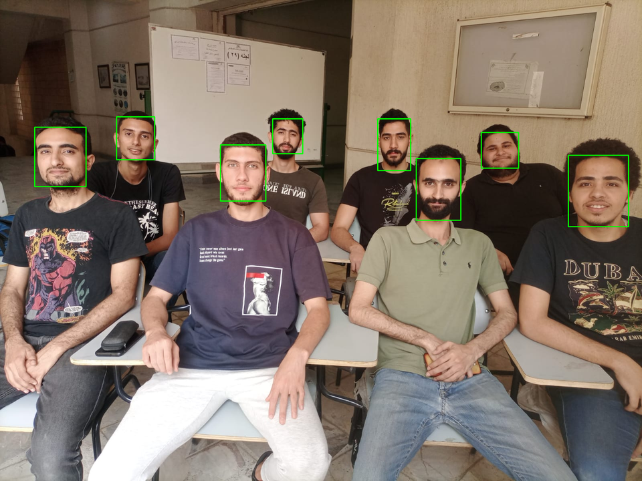
Traditional
Attendance
Modern
Attendance
Traditional attendance is time-consuming and inefficient
Automated and easier attendance methods are much faster and more efficient

Slide 7
overview of the attendance system

Slide 8
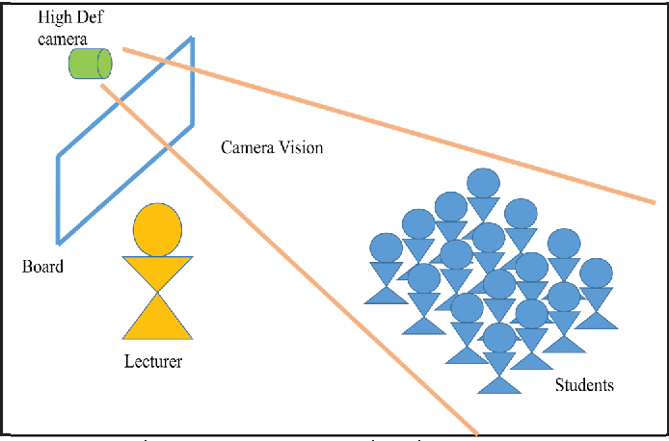

System
Overview
At a high level, our attendance system works by using advanced facial recognition technology.
Our attendance system includes:
Facial recognition technology:
Using face detection and recognition methods
Real-Time tracking:
Helps in addressing absences immediately
Automated attendance:
Improves attendance accuracy and efficiency.

Slide 9

Streamline processing:
Reduce paperwork in attendance record-keeping
Complete education system:
Integrated environment for education and its features
Course management:
Tools for monitoring courses and navigate its content
Easy to navigate interface:
Well developed interface with defined routes

Slide 10
Attendance System analysis
High-Level Look at the system details

Slide 11
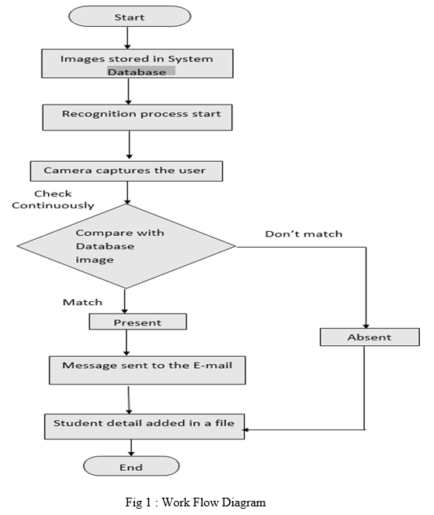
Attendance system
How attendance system works?
The key features in the system.
Steps for taking attendance.
Report the attendance.

Slide 12





Attendance steps
Report Attendance
Face detection
Capture Image
Face Recognition

Slide 13
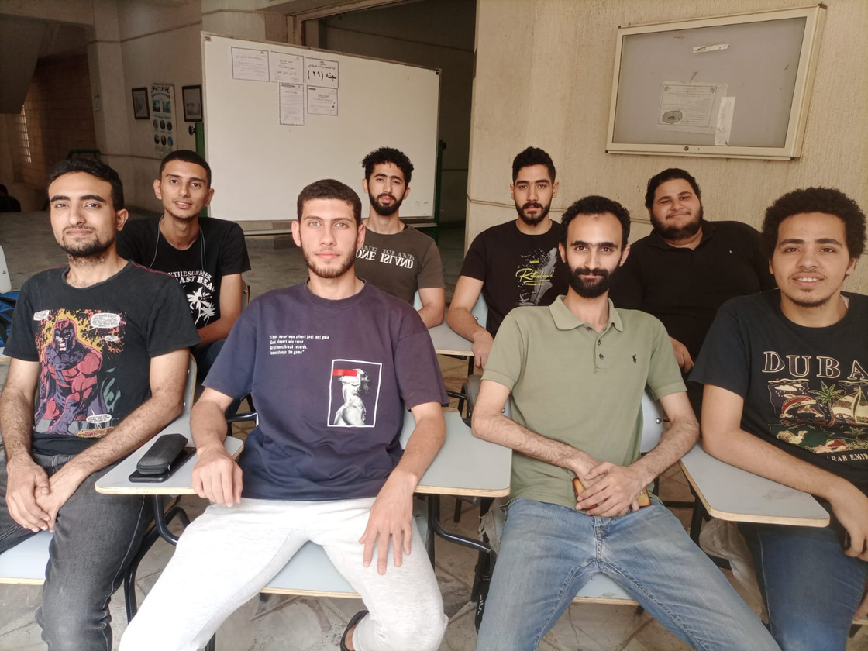
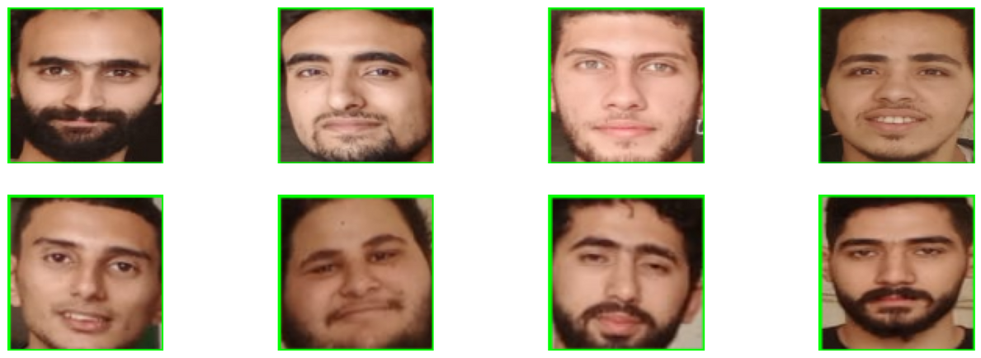
Multi-Face Attendance
Take image for the student at register and crop his face
Take a photo for the class
Crop the faces of the photo
Compare the register image with the cropped images to identify the person
Return a report of the ID s of the present students

Slide 14
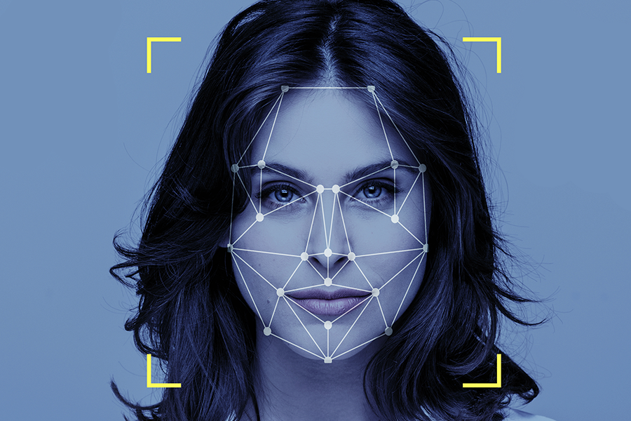
Face Detection
What is face detection technology
What is its applications
Face detection model detects and localizes the face in the input image.
Convolutional Neural Network with multiple layers
Single shot detection vs Haar Cascade vs Faster R-cnn

Slide 15
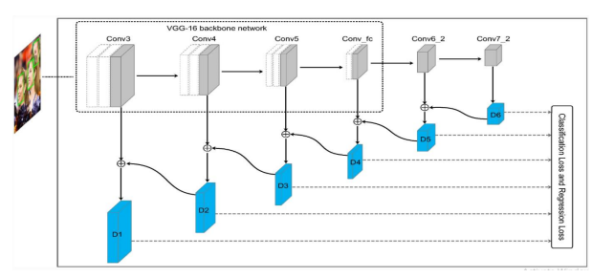
Single shot detector
VGG-16 Backbone network
Pyramid features and Convolutional and Deconvolutional layers
Output image(corrupted image) = (128 , 128)
average precision of 94.12% on the WIDER FACE dataset.

Slide 16
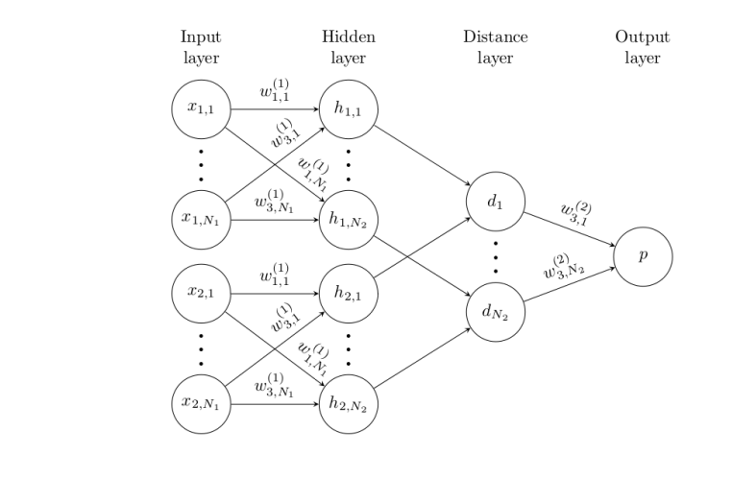
Face recognation
What is the facial recognation technologies
What its applications
Proposed models (VGG VS Xception)
One shot learning
Siamese convolutional neural network
Siamese neural network and normal convolutional neural network

Slide 17
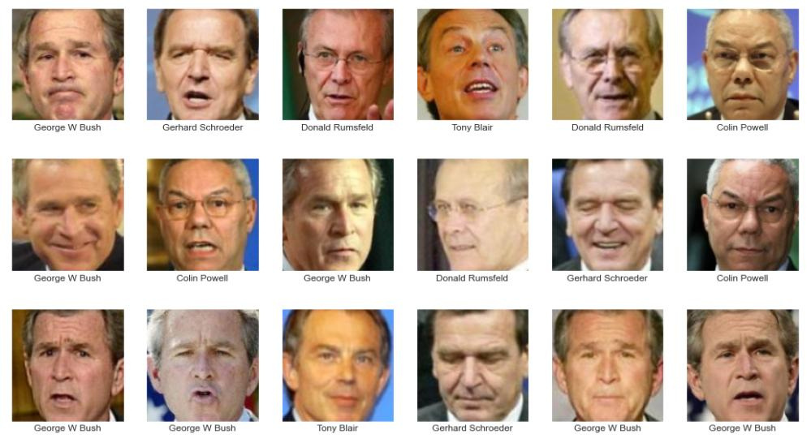
Data set
We used for training the model :
LWF (Labelled Faces in the Wild)
Extracted faces data set from Kaggel
This data set contain the extracted faces from public figures like presidents and famous actors and famous political figures
We distribute the data set as following
train set: 1191
test set : 133
Which the single unite represent a one person face

Slide 18
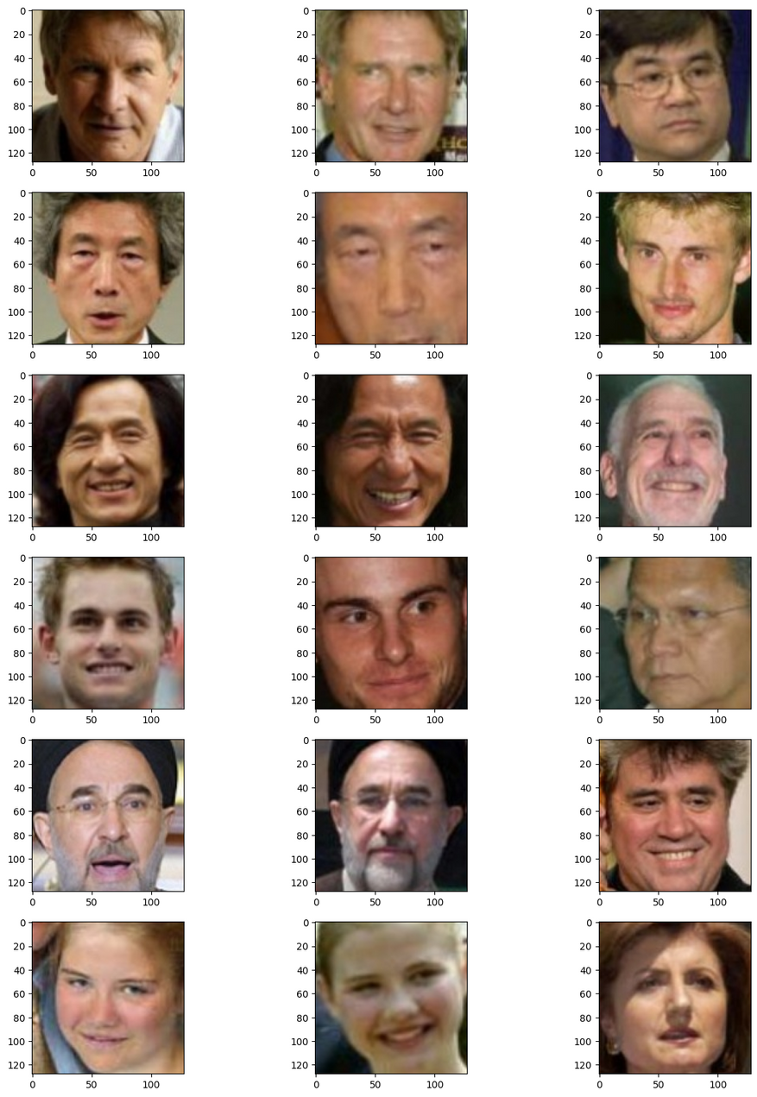
Pre-Processing
Resize image to (128,128)
then we store this image in triplet that contain (anchor, positive, negative)
we shuffle it and then store it for train and test
Number of training triplets: 10237
Number of testing triplets : 994

Slide 19
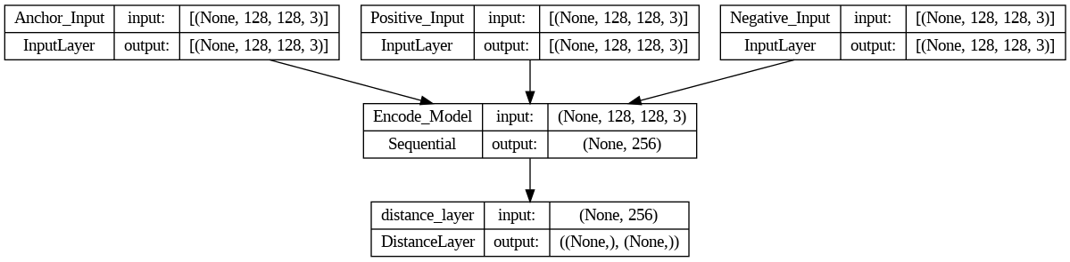
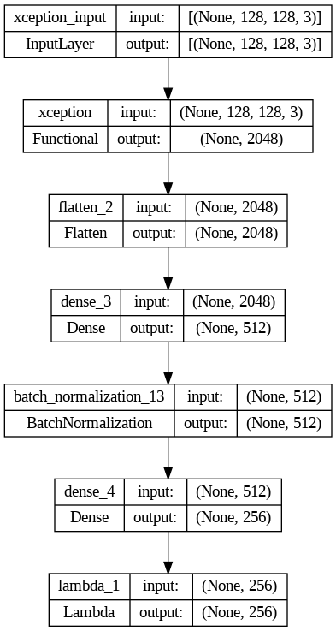
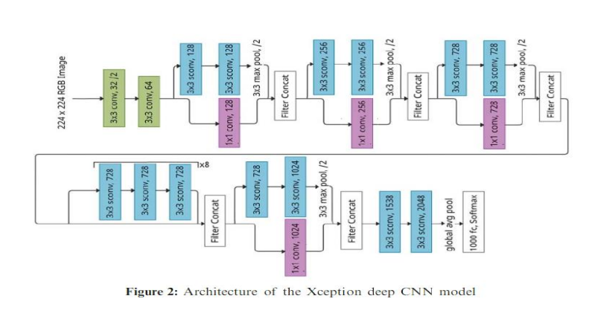
model architecture

Slide 20
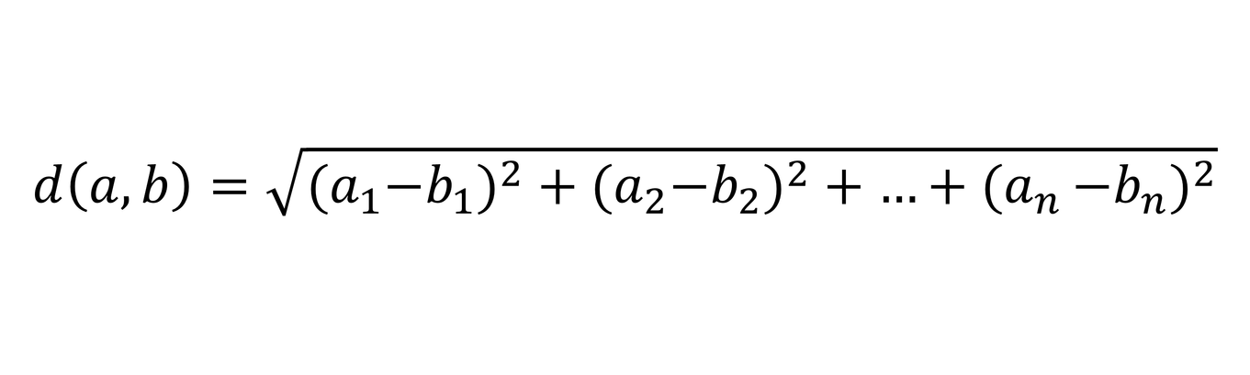
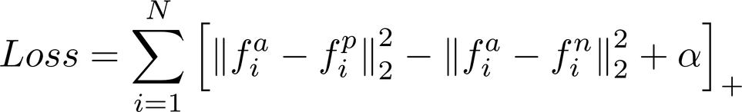
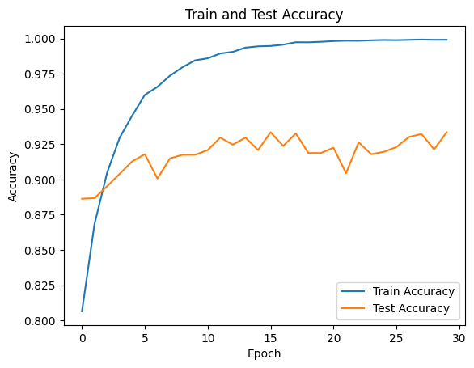
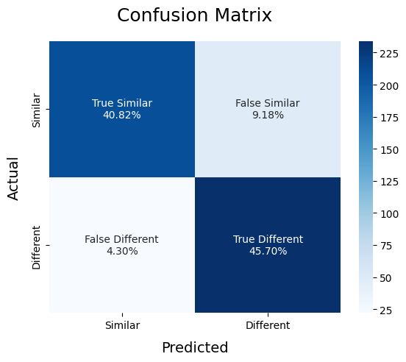
Distance calculation and Accuracy
Here we use triplet loss function with to calculate the distance between:
anchor and positive
anchor and negative
This is our Loss function :

Slide 21




Educational System

Slide 22


System Architecture
The system will have three main user roles:
Teacher
Student
Administrator
Teachers will be able to upload and manage courses, lessons, and quizzes.
Students will be able to access and view these courses, lessons, and quizzes.
Administrators will be able to manage attendance and monitor progress.

Slide 23
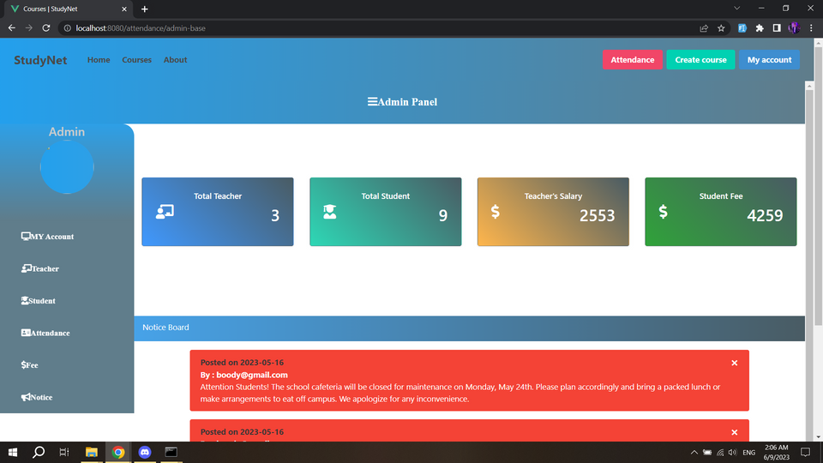
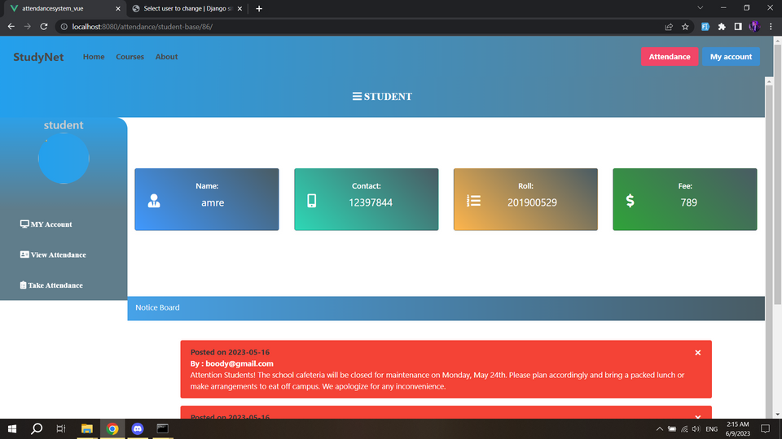
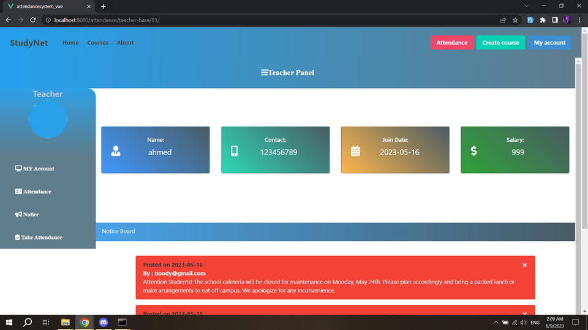
Features
The system will use face recognition and detection to allow students to take their attendance by themselves.
Provide options for teachers and administrators to take attendance for students either manually or with the help of face recognition and detection .
The system will generate reports on attendance for individual students as well as the entire class.
Teachers and administrators will be able to view real-time visibility into attendance data.

Slide 24
Result and Conclusion

Slide 25
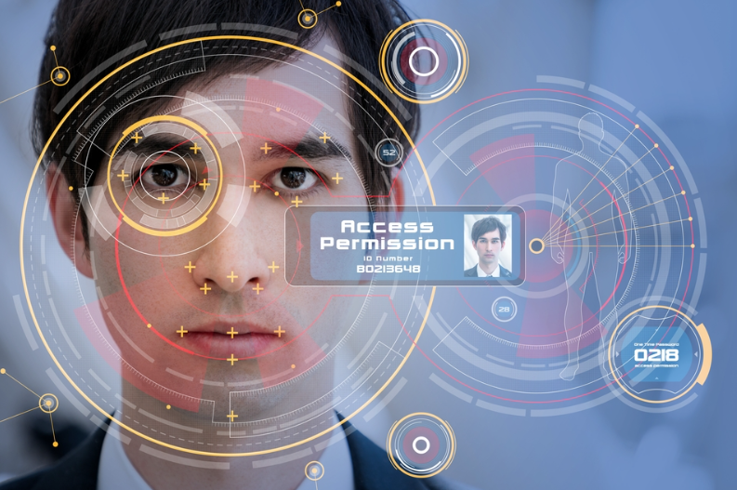
Conclusion & Potential Features
The System is a powerful tool that can help streamline the education process.
The use of advanced biometric technology will help prevent fraud and cheating.
In the future, we plan to add more features to the system, such as personalized learning and AI-driven assessments.
We believe that this system has the potential to revolutionize education and make it more accessible and effective for everyone.
Mobile Compatibility:
The system can be accessed through mobile devices for greater convenience.

Slide 26
THANK YOU
Any questions?

